Slide 1
Mesh Refinement: Aiding Research in Synthetic Jet Actuation
By:
Brian Cowley

Slide 2
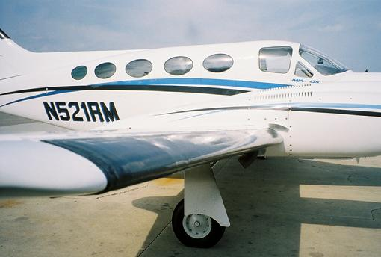
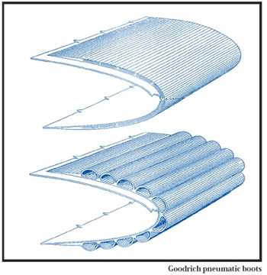
Background – Definition and Implementation:
Synthetic Jet flow actuation is a method for controlling airflow over airplane wings
Implementation:
Electrodes over leading edge
High frequency pulse from boot-like actuators
Standard Boot Actuator:
Internal Structure:

Slide 3
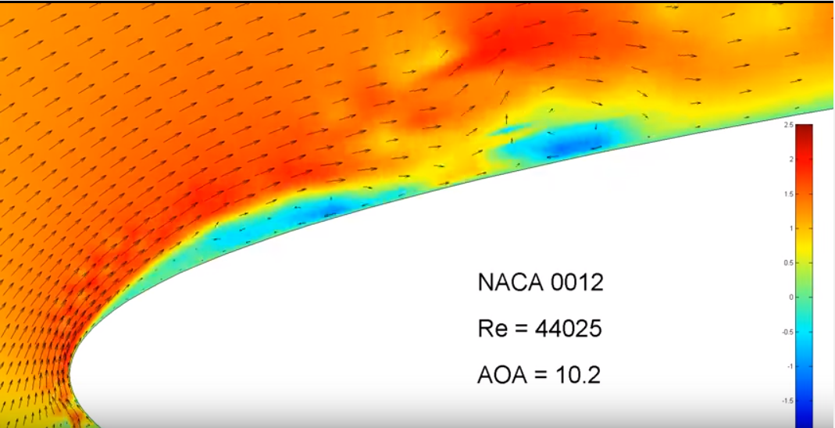
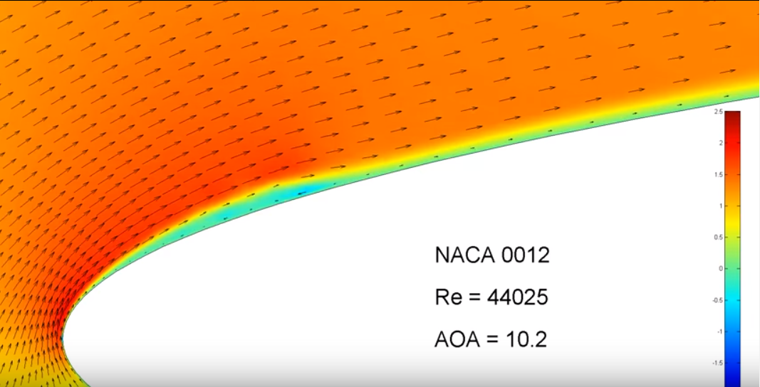
Background – Benefits and Results:
Benefits:
Reduced boundary layer thickness (Translates to reduction in drag)
Delays the onset of boundary layer separation at high angles of attack
Helps flow re-attach after post stalled conditions
Results:
Airplanes would require less fuel to fly the same distance
An increased flight envelope
Standard flow at moderate angle of attack:
Flow with synthetic jet at moderate angle of attack:
https://www.youtube.com/watch?v=IytDva1y09E&feature=youtu.be

Slide 4
Current Research at Embry-Riddle – Overview:
Objective: test current hypotheses
1: Generating an optimized Synthetic Jet Flow will result in a re-attached
boundary layer in posed stalled conditions
2: Synthetic Jet flow will reduce boundary layer height in attached flow
conditions
3: There exists a parameter space (set of flight conditions) that will optimize
the results of synthetic jet flow

Slide 5
Current Research at Embry-Riddle – Methods:
Currently use CFD to model synthetic jet flow
In house made software written in FORTRAN95
Uses a Direct Navier-Stokes solver with a forward time, central space solving scheme
Geometry is fixed to a NACCA 0012
Current software allows the user to:
Specify mesh size and spacing
Reynolds Number
Angle of attack
Boundary conditions
Synthetic jet strength and location

Slide 6
Research Limitations – The Problem:
Models that are needed to effectively test the hypotheses need to be scaled up compared to previous models
In terms of both Reynolds number and mesh size
Allow more detail to be shown in boundary layer-jet interaction
Allow the study of larger wings (Such as a Boeing 747)
The problem: current software cannot effectively scale current models to test larger wings or more detailed problems
Result of time it takes to run on large meshes or at high Reynolds numbers
Result of computational complexity

Slide 7
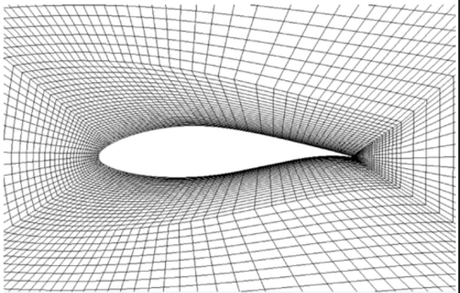
Research Limitations – Complexity:
Example Mesh:
For Example:
A mesh the research group considers large is 800 X 1600
Number of nodes = 1.28 million
Number of time steps = 1.2 million
Average iterations to converge per time step = 4
Calculations = 6.14 X 10¹²
Computation time = 1.5 days
The example mesh of realistic quality is 4.5 million nodes

Slide 8
Research Limitations – Complexity:
Clearly moving up the complexity of the problem leads to unrealistic time to collect data – So what do we do?
We define a quantity known as the “Residual”
LHS – RHS = 0
Result gives us the error within the calculation at that point between each time step
We are held back from using a courser mesh for a problem because of the errors that are associated with it
Lead to inaccurate or flat out wrong results

Slide 9
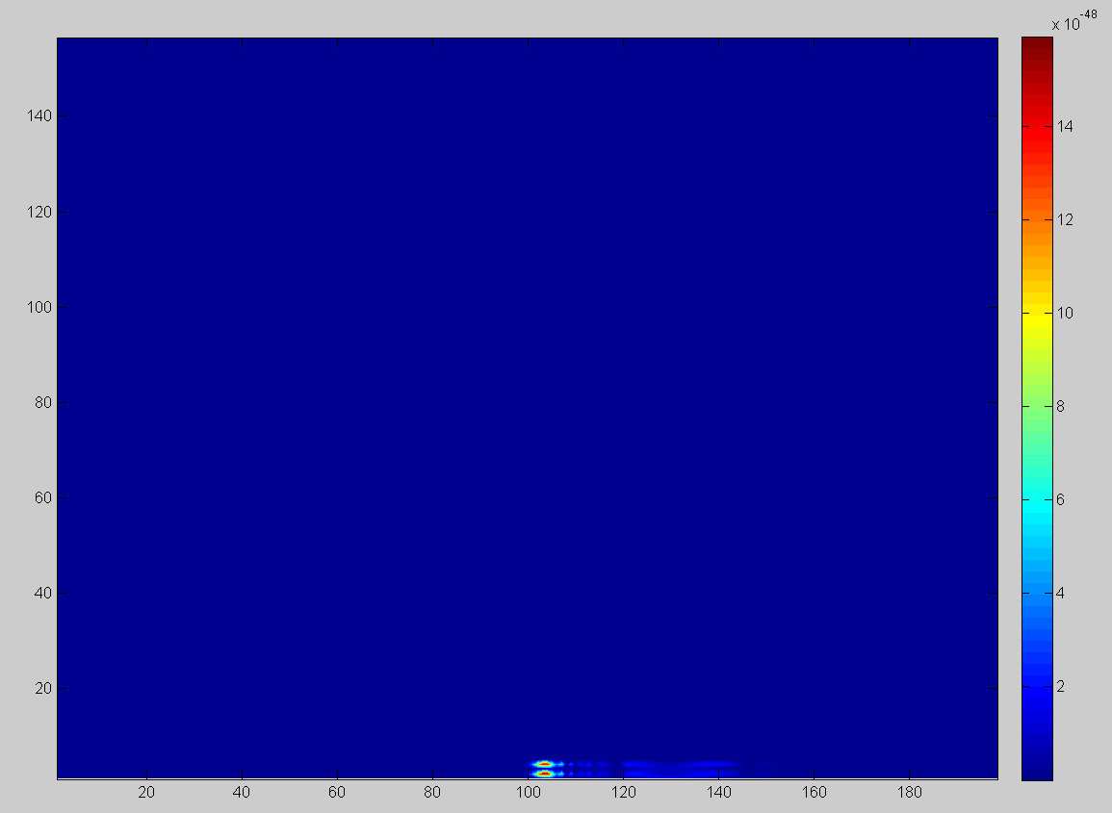
Current Project – Beginning Investigation:
Residual Field for 200 X 400 model:
I wanted to simply plot the residuals to see where they were
Residuals migrate to the right
Appear directly above the leading edge of airfoil
Beginning question: What if they could be contained?

Slide 10
Solution
Write an add on (new sub-routines) to the existing code
eliminate, or reduce the residuals within models
Allows them to be scaled as desired

Slide 11
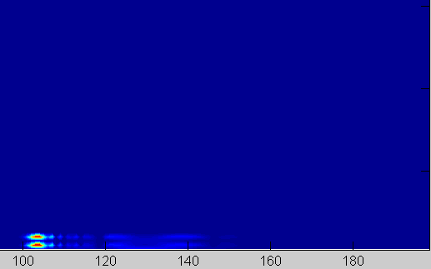
Current Project – Code Development Part 1:
First subroutine searches for the highest residual value
Draws a box around the region to user specified dimensions
Activates after user specified time steps

Slide 12
Current Project – Code Development Part 2:
Subroutine two increases mesh density within the region
Leads to high precision calculation within region
Eliminates residual between time steps
Original Mesh
Note:
Blue Nodes: Original, contain original values
Black Nodes: Re-Meshed nodes
Edge nodes are weighted average of adjacent values
Interior initially calculated by solver
Refined Mesh

Slide 13
Current Project – Code Development Part 3:
The next subroutines run values through the DNS solver
Each routine is defined for the new mesh size
The solver calculates to a user defined tolerance within this configuration

Slide 14
Current Project – Code Development Part 4:
Last subroutine places processed data into main program
Does this with respect to original position
Program then continues to compute the result
Result of Refined mesh
Region within Main Program

Slide 15
Progress:
This is an ongoing project:
Each subroutine within the new code has been added
Debugging is current stage of development

Slide 16
Next Steps:
Finish debugging the code
Run trial runs with the new code VS. original
Done to validate code
Use the new version of the code to test hypotheses

Slide 17
Project Goals:
Reduce the time required to compute the needed data
Enable the ability to acquire higher quality data within a timely manor
Both goals to be met on student’s personal computers

Slide 18

Questions?

